Slide 1
Title: Random weights
Aim:
Calculate cost per kilo from random weights
Plan:
Review Probability
Price per kilo

Slide 2
Choral response
Sample space is the list of ALL possible outcomes of a trial.
Sample space is the list of ___ possible outcomes of a trial.
Sample space is the list of ___ possible ________ of a trial.
What is a sample space?

Slide 3
Sample space
A normal 6-sided die is rolled.
Which is the correct sample space?
S = 1 – 6
S = {1 – 6}
S = {1, 2, 3, 4, 5, 6}

Slide 4
Probability scale
0
0.5
1
LIKELY
IMPOSSIBLE
CERTAIN
UNLIKELY
EVEN

Slide 5
Examples
Probability scale
0
0.5
1
IMPOSSIBLE
UNLIKELY
EVEN
LIKELY
CERTAIN
Where would these events sit?
Rolling an even number on a normal die
Snowing in Busselton in December
Mr. Davies catching a fish on Sunday
Rolling a 1 on a normal die
Getting a number less than 7 on a normal die

Slide 6
Review: price per 100g
IF the price is in Kg (e.g. $14 per Kg) how do we convert it to price per 100g?
Divide by 10!
If the price is per 100g (e.g. $1.20 per 100g) how do we convert to price per Kg?
Times by 10!

Slide 7
I do, we do
Price per Kg
Price per 100g
Convert to 100g price:
$12.50 per Kg
$7.50 per Kg
$24 per kg
$40 per Kg
Convert to Kg price:
$0.45 per 100g
$1.02 per 100g
$0.65 per 100g
$3.15 per 100g

Slide 8
You do – exercise books
Convert to Kg price
Convert to 100g price
$2 per 100g
$0.54 per 100g
$0.45 per 100g
$5.17 per 100g
$2.10 per 200g
$13.50 per kilo
$18 per kilo
$22.70 per kilo
$3.50 per kilo
$15 for 2 kilo

Slide 9
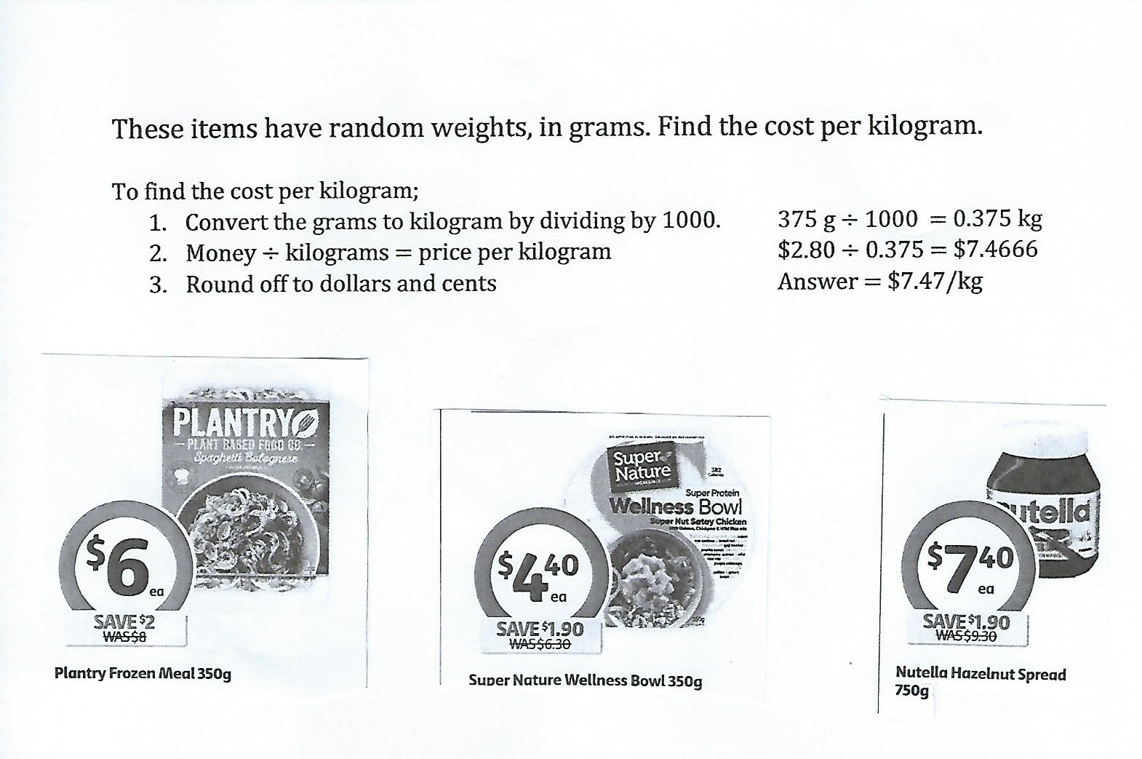
Cost per Kilogram from Random Weights
Requirements
Calculator
Best Buys page 4 worksheet

Slide 10
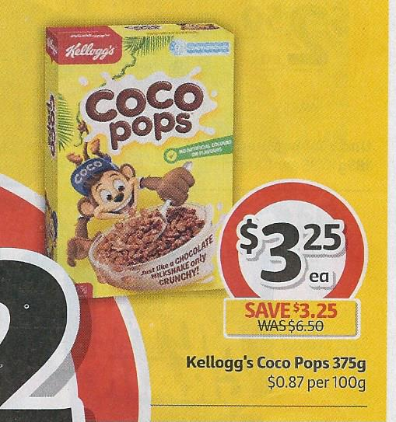
Cost per Kilogram from Random Weights
This item has a random weight, in grams.
To find the cost per kilogram for Coco Pops
Convert the grams to kilograms by dividing by 1000 375 ÷ 1000 = …… kg
Money ÷ kilograms = price per kilogram $3.25 ÷ 0.375 = 8.6666666
Round off to dollars and cents $ ………. per kilogram

Slide 11
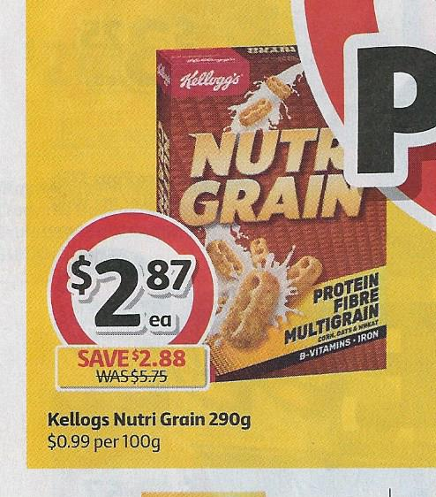
Cost per Kilogram from Random Weights
To find the cost per kilogram for Nutrigrain
Convert the grams to kilograms by dividing by 1000 ……. ÷ 1000 = …… kg
Money ÷ kilograms = price per kilogram $......... ÷ 0.290 = ………..
Round off to dollars and cents $ ………. per kg

Slide 12
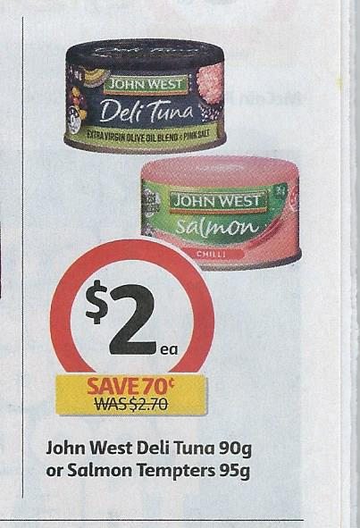
Cost per Kilogram from Random Weights
To find the cost per kilogram for Deli Tuna
Convert the grams to kilograms by dividing by 1000 ……. ÷ = …… kg
Money ÷ kilograms = price per kilogram $2.00 ÷ ……… = ………..
Round off to dollars and cents $ ………. / kg

Slide 13
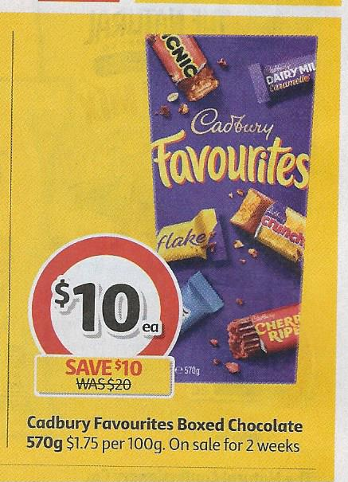
Cost per Kilogram from Random Weights
To find the cost per kilogram for Favourites chocolates
Convert the grams to kilograms by dividing by 1000 ……. ÷ = …… kg
Money ÷ kilograms = price per kilogram $.......... ÷ ……… = ………..
Round off to dollars and cents $ ……. / kg

Slide 14
Cost per Kilogram from Random Weights
To find the cost per kilogram for Nutrigrain
Convert the grams to kilograms by dividing by 1000
Money ÷ kilograms = price per kilogram
Round off to dollars and cents

Slide 15
Cost per Kilogram from Random Weights
To find the cost per kilogram for Deli Tuna
Convert the grams to kilograms by dividing by 1000
Money ÷ kilograms = price per kilogram
Round off to dollars and cents

Slide 16
Cost per Kilogram from Random Weights
To find the cost per kilogram for Favourites chocolates
Convert the grams to kilograms by dividing by 1000
Money ÷ kilograms = price per kilogram
Round off to dollars and cents

Slide 17
Individual practice
Complete task sheet with random weights

